Slide 1
The Integumentary System

Slide 2
Did you know . . . .
What hurts if you pull it, but doesn't hurt if you cut it?
Your hair, of course!
Skin is elastic - it springs back into shape when stretched.
Some medicines (estrogen, nicotine) can pass through the skin, but others cannot (insulin).
Why is that? Because only fat-soluble substances can enter the skin, not water-soluble ones.

Slide 3
The integumentary system is made up of
Skin
________
Nails
________
Sensory __________
Hair
Glands
receptors
Parts of the Integumentary System

Slide 4
Functions of Skin
Regulate body temperature
____________
_______ sensations
_________ and absorbs substances
__________ vitamin D
Protection
Detects
Excretes
Synthesizes
Structures of the integumentary system

Slide 5
Layers of skin
Epidermis
Dermis
Subcutaneous layer (hypodermis)
Layers of skin

Slide 6
Epidermis
5 layers
_______________
______________
Nutrients ______ from dermis
Keratinized cells
Avascular
diffuse
Layers of the epidermis

Slide 7
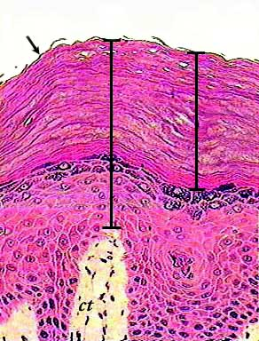
Keratinization
Keratin (protein) is _________into cells
Cells become _________and _________ as they move up
___________ and softens cells
deposited
hardened
flattened
Keratinization of cells
Water proofs

Slide 8
Layers of the epidermis
Stratum basale (closest to the dermis)
Stratum spinosum
Stratum granulosum
Stratum lucidum
Stratum corneum (most superficial layer)
Layers of the epidermis

Slide 9
Stratum basale
Go through ________
Replace cells in __________________
Cells ______ as they are pushed towards the ________
mitosis
superficial layers
die
surface
Cells die and flatten
Notes:
Cells can be columnar or cuboidal
Which layer of the epidermis would act as a layer of stem cells? Why?
Some question that deals with the cells being close to the blood supply.

Slide 10
Stratum granulosum
Structures in cells release _______
Cells ______
lipids
die

Slide 11
Stratum corneum
30 cells thick
No longer _________ cells
Cells are flattened and fill with ______(binds)
A _________ membrane
Cells closer to surface _________
individual
lipids
continuous
shed off
Stratum corneum sample (using tape)

Slide 12
Table Talk
What enables the stratum corneum to act at a protective layer?
How are layers of the epidermis able to remain alive without a blood supply?
Notes:
Explain why the stratum corneum is used as a protective layer. Stratum corneum
Stratified squamous epithelial cells

Slide 13
Number of skin layers
6 or 7
Thick vs Thin
Thicker in _______________
Ex. _______________
high friction areas
Fingers and toes
The epidermis
Notes:
Thick skin has five layers and think skin has four. We have six layers of skin if you do not include the hypodermis

Slide 14
Dermis and hypodermis
Dermis
Dense fibrous connective tissue
_______________
____________ structures
Subcutaneous layer (hypodermis)
___________________
Collagen and elastic fibers
Specialized
Fat and blood vessels

Slide 15
Melanin
Provides color and ______________
Color ranges from yellow to black
UV protection

Slide 16
Structures within the Dermis

Slide 17
Which of these animals can get goose bumps?

Slide 18
Hair
Dead Keratinized cells
Color produced by _________
Hair color and aging
Melanocytes are ______________
melanin
damaged or die

Slide 19
Sweat glands
Eccrine sweat gland
Regulate body temp
Release sweat in ________________
Apocrine sweat glands
Do not function until __________ puberty
Sweat is _________
response to emotion
puberty
odorless

Slide 20
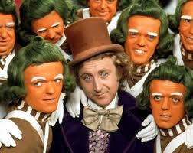
Skin Color
3 pigments
Melanin
___________
___________
Sun Exposure:
Necessary to produce __________
Increased exposure
_________
Increased _____________
Hemoglobin
Carotene
Vitamin D
Darker skin
risk of cancer
Notes:
Increased exposure leads to an increase in the production of melanin which leads to the darkening of the skin.

Slide 21
Cancer
Overgrowth of cells
_________
_________
DNA is damaged
Cell cycle malfunctions
Size
Quantity

Slide 22
How Sunlight affects the skin
What is the difference between sun poisoning and sun burn? Who is more likely to get sun poisoning?
Is there a correlation between the amount of melanin in the skin and damage to the skin?
Who is more likely to get skin cancer light skinned people or dark skinned people? Why?
How was the skin affected when you moved the exposure bar from dark skin to light skin?

Slide 23
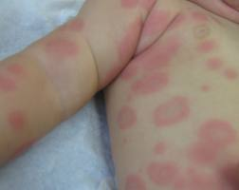
Skin as an indicator
Cyanotonic
Blood is not picking up enough oxygen
Skin turns ________
Erythmea
___________ of skin
Capillaries engorged with ________
Heat, infection, inflammation, etc.
bluish-purple
Redness
blood

Slide 25
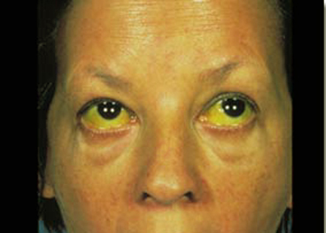
Jaundice
Yellow skin and whites of the eyes
Excess _________in blood
Indicates ________ in adults
_____________ function in infants
bilirubin
liver disease
Immature liver

Slide 26
Treatment
Adults
__________
______
Usually meds
Infants
Exposure to UV light
___________
Dependent on cause
Increases excretion of bilirubin
Notes:
Adults: treatment is dependent on cause, coud be: meds, supportive care, blood transfusion, surgery
The light allows for increased excretion of bilirubin in urine or stool. The shape of the bilirubin molecule is changed to allow for this.

Slide 27
Table Talk
Which type of sweat gland helps maintain homeostasis?
Who would have a greater risk of getting skin cancer, an African American Cal Trans employee or an African American baseball player? Why?
Why does the treatment for jaundice differ in adults and infants?

Slide 28
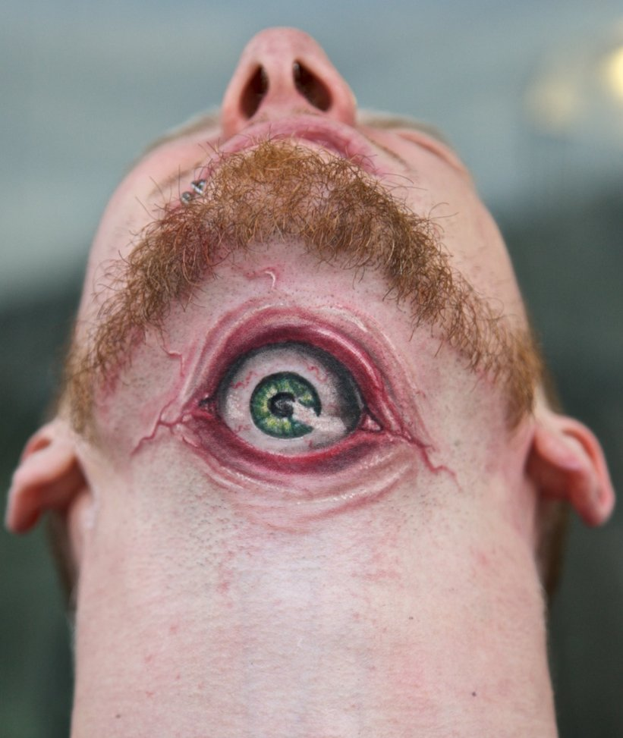
Tattoos
Inked deposited into
________
Why?
Layer is __________
Inked cells are trapped
dermis
permanent
https://www.youtube.com/watch?v=DMuBif1mJz0
Notes:
Ink is injected into the dermis. Can fade over time due to exposure to sun, improper healing, etc. How are they removed?

Slide 29
Facelift before and after

Slide 30
Body Augmentation
Face Lift
http://www.youtube.com/watch?v=hEJ2KnrOxSg

Slide 31
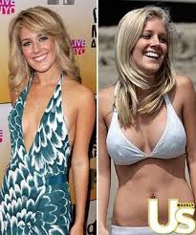
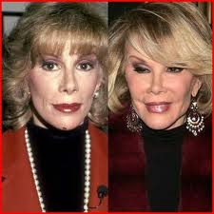
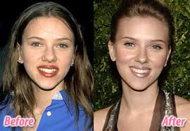
body augmentation
Elaine Davidson
Notes:
Needle is pushed through skin and tissues. Total healing can take up to a year

Slide 32
Health Risks of Body Augmentation
Which trends are popular among your peers?
What risks are involved with certain types of body augmentation?
Should teens be allowed to augment their bodies? Why or why not?

Slide 33
Health Risks of Body Augmentation
Liposuction Clip
http://www.youtube.com/watch?v=nfRsBijqS4E&oref=http%3A%2F%2Fwww.youtube.com%2Fwatch%3Fv%3DnfRsBijqS4E&has_verified=1
Teen Plastic Surgery Clips
https://www.youtube.com/watch?v=iVf4uquOyXw
https://www.youtube.com/watch?v=sFAcgWOH2Mg

Slide 34
Removal/repair
https://www.youtube.com/watch?v=XGyYuz1aMGU
https://www.youtube.com/watch?v=17n2zSXPwuc

Slide 35
Fact or Fiction
http://www.youtube.com/watch?v=4iJVWMR4Uq0&list=PL6SJY8-nLqZousdoE53-Al4O_XAOR9CjA
The Fugate Family
http://www.youtube.com/watch?v=ahihGKZC5Kk
Paul Karason

Slide 36
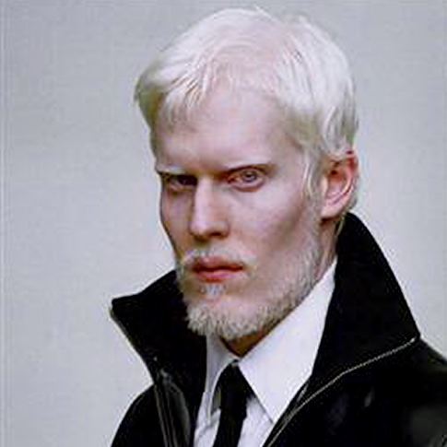
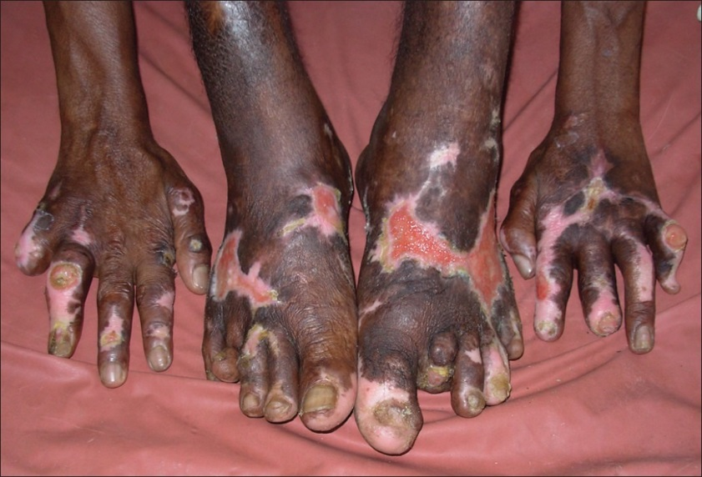
Integumentary System disorders Poster

Slide 37
Burns http://www.youtube.com/watch?v=CNQ_uW66LfU
Causes of burns:
____________
____________
____________
1st degree burns
_____________
2nd degree burns
_______________________
_____________
3rd degree burns
_______________
_______________
Chemicals
Extreme heat
Electricity
Redness
Redness and blistering
1st two layers
All layers damaged
No pain

Slide 38
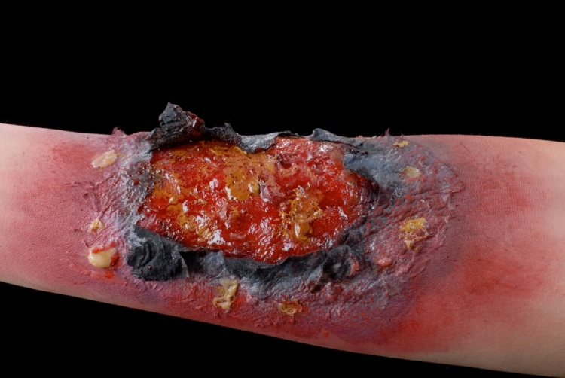
Types of burns

Slide 39
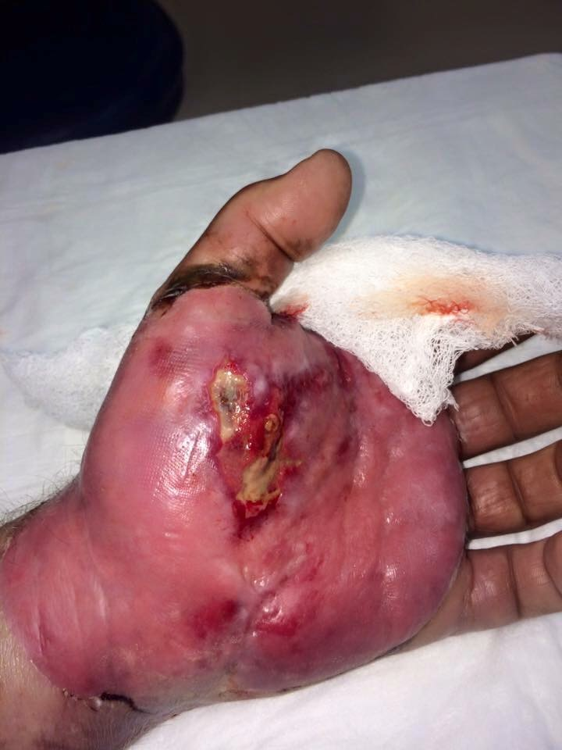
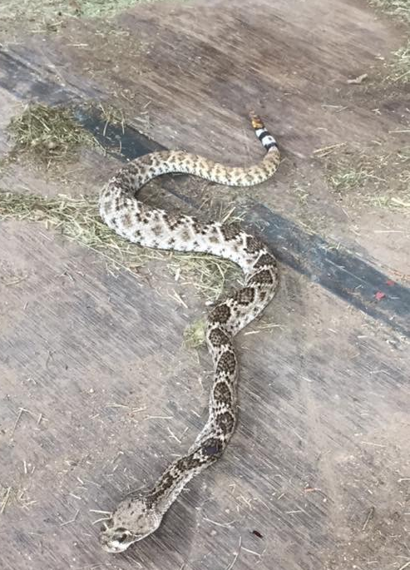

Slide 40
Rule-of-Nines

Slide 42
Treatment of burns
1st and 2nd
_________
Cover with gauze
Pain reliever
3rd
Don’t cool
______________ clothing
____________burnt part
Cover
Cool burn
Don’t remove
Elevate

Slide 43
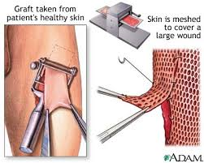
Skin Graft
Needed when the ______________ and __________ are destroyed.
Transfer of __________ healthy skin to a donor site
The process:
______________
______________
______________
stratum basale
http://www.youtube.com/watch?v=7ZYrw2fYk8U&oref=http%3A%2F%2Fwww.youtube.com%2Fwatch%3Fv%3D7ZYrw2fYk8U&has_verified=1
Stem cells
healthy skin
Obtain donor skin
Poke holes
Attach to wound site

Slide 45
Skin and water
Wrinkles during prolonged exposure
________ is washed away
Science of “winkley” hands
__________ swell, living do not
Provide __________ to grip objects
Sebum
Dead cells
surface area
Notes:
It was thought that water moved into the skin, now researchers think that it is a response from the autonomic nervous system.
The water is trapped between the two layers and has not where to go. http://health.howstuffworks.com/skin-care/information/anatomy/skin-wrinkly-in-water.htm

Slide 46
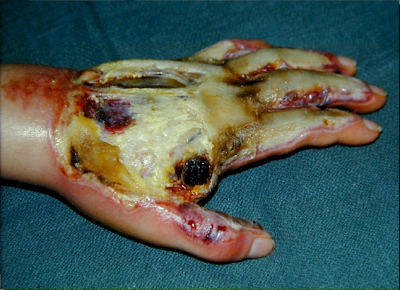
Case study #1
You attempt to re-warm a hypothermic patient using hot water and zip-lock bags. Your attempt was thwarted when you attempted to remove the zip-lock which had adhered to the skin. The skin in the affected areas was removed when you took the bag off. The bags were placed over the entire body except the head, neck and perineum.
What percentage of the
body was burned?
Which degree burn did
your patient suffer from?

Slide 47
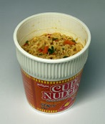
Case Study #2
A toddler spills a steaming cup-o-noodles over her the left side of her head and her left anterior torso. She develops blistering, redness and intense pain over the affected areas of her body. She later develops a fungal infection.
What percentage of her body is burned?
Which degree burn is she suffering from?

Slide 48
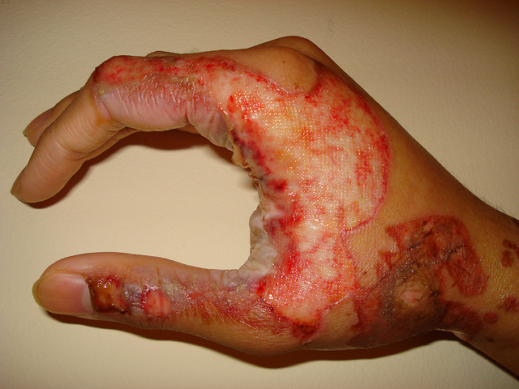
Case Study #3
A boiler explodes and burns an unsuspecting victim who has walked by mid-blast. His entire body is burned with the exception of his perineum and right anterior thigh.
What percentage of
his body is burned?
Which degree is burn is
your patient suffering
from?

Slide 49
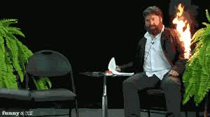
Case Study #4
A mechanic is working on a car. Gas is accidentally sprayed on his arm which then catches fire. He was wearing a jacket at the time of the accident, which ended up being burned into his skin.
Would it be wise to attempt to remove the jacket from his body? Why or why not?
What percentage of his body has been burned?

Slide 50
Case Study #5
A young girl accidentally lit her sweater on fire while she was blowing out her birthday candles. The entire right side of arm is burned, she tells her mom that she is fine and does not feel any pain. Yet, her skin is charred and the hypodermis is visible.
What percentage of her body has been burned?
Which degree burn is your patient suffering from?
Why can’t your patient feel pain even though she has been burned?

Slide 51
On the inside: Burn center
https://www.youtube.com/watch?v=7gA_a9FXIBo

